Slide 1
Jesus Scholarship Foundation

Slide 2
Jesus Scholarship Foundation is dedicated in bringing hope and a future for those poor children in the Philippines by supporting their education & their spiritual growth…

Slide 3
JSF Graduates 2022-2023

Slide 4
Dhanniele Montejo Bachelor of Arts in Communication

Slide 5
Joevin Bahilango Bachelor of Science in Education Lucban Quezon

Slide 6
Maribeth Ventura Bachelor of Science in Secondary Education

Slide 7
Arcelyn Castro Lazara Bachelor of Science in Radiation Technology

Slide 8
Khristine Plaza Bachelor of Science in Elementary Education

Slide 9
Erica Castro Bachelor of Science in Business Administration

Slide 10
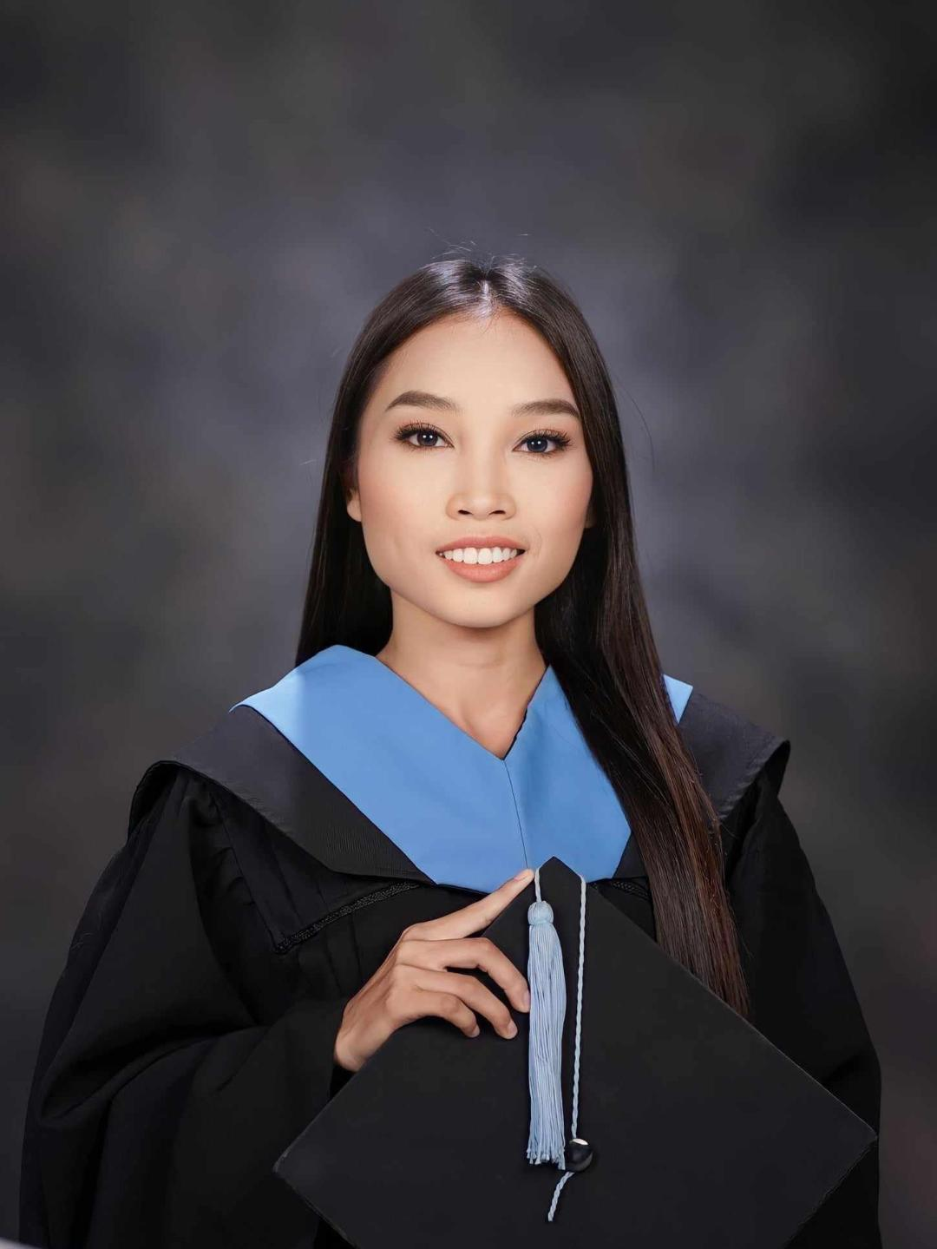
Jamaica Rivera Asuncion Bachelor of Science in Education

Slide 11
JSF Graduates 2023-2024

Slide 12
Jemicha Micole G. Parial Bachelor of Science in Nursing

Slide 13
Juanito Manayao Bachelor of Science in Education

Slide 14
Jelamaei Manayao Bachelor of Science in Hotel Management

Slide 15
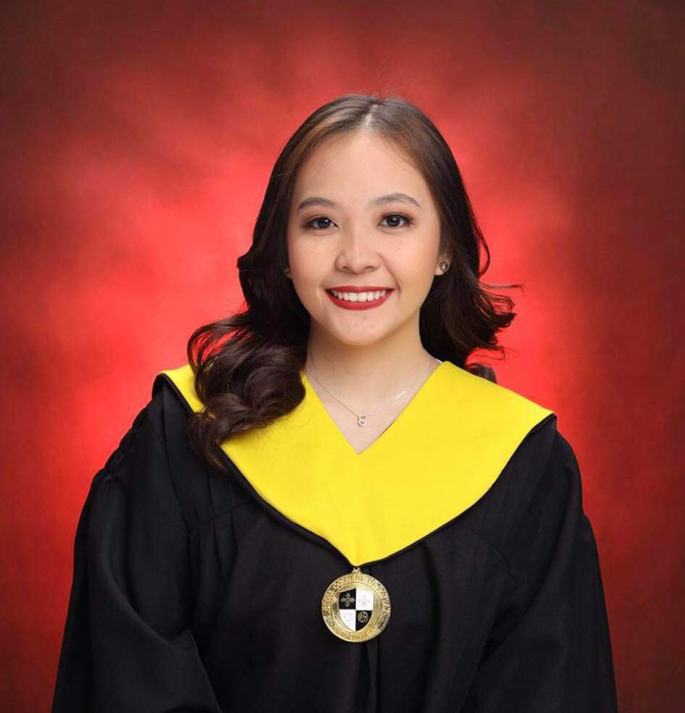
Lyca Marchan Bachelor of Science in Accountancy

Slide 16
Patriz San Jose Bachelor of Science in Criminology

Slide 17
Janelle Javier Bachelor of Science in Business Administration

Slide 18
Andrealyn Magsilang Bachelor of Science in Business Administration

Slide 19
JSF Scholars 2024-2025

Slide 20
Jesus Scholars in Nueva Ecija 2024-2025

Slide 21
JSF Scholars Elementary-High School

Slide 22
JSF College Scholars

Slide 23
Kryle Ramirez 1st year Bachelor of Science in Education

Slide 24
Princess Bermejo 1st year Bachelor of Science in Accountancy

Slide 25
Jonnalene May Julian 1st year Bachelor of Science in Accountancy

Slide 26
Nicka Rose Galang 1st year Bachelor of Science in Hotel Management

Slide 27
Tristan Hererra 1st year Bachelor of Science in Criminology

Slide 28
Gervy Carlos 1st year Bachelor of Science in Information Technology

Slide 29
Jonathan Asuncion 1st year Bachelor of Science in Hotel Management

Slide 30
Emmanuel Marquez Jr. 1st year Bachelor of Science in Information Technology

Slide 31
Timothy Santiago 1st year Bachelor of Science in Information Technology

Slide 32
Renz Causon 1st year Bachelor of Science in Computer Science

Slide 33
Nicole Viron 2nd year Bachelor of Science in Tourism

Slide 34
May Mariel Linsangan 2nd year Bachelor of Science in MHR

Slide 35
Marvin Tupiano 3rd year Bachelor of Science in Mechanical Engineering

Slide 36
Erica Jane Lacaden 3rd year Bachelor of Science in Education

Slide 37
Hanna Lorraine Deleon 3rd year Bachelor of Science in Computer Engineering

Slide 38
Noemi Joyce Hererra 3rd year Bachelor of Science in Education

Slide 39
Mia May Causon 3rd year Bachelor of Science in Criminology

Slide 40
Mary Jane Magsilang 4th year Bachelor of Science in Business Administration

Slide 41
Roldan Longalong 4th year Bachelor of Science in Hotel Management

Slide 42
Rhezalyne San Pedro 4th year Bachelor of Science in Education

Slide 43
Yien Shane Ampaya 4th year Bachelor of Science in Education

Slide 44
Julius Cesar Reyes 4th year Bachelor of Science in Information Technology

Slide 45
JM Pascual 4th year Bachelor of Science in Education

Slide 46
Liam Jazel Dela Cruz 4th year Bachelor of Science in Marine Transportation

Slide 47
JSF Scholars Outside Nueva Ecija 2024-2025

Slide 48
Gerand Alexander Bachelor of Science in Nursing 2nd year Maryhill College , Lucena City

Slide 49
Karylle Dela cruz Bachelor of Science in Information technology Philippine Institute of Technology, Quezon City

Slide 50
Vince Enriquez Grade 8 Cavite City

Slide 51
Marielle Talahiban 4th year Bachelor of Science in Education St. Mary’s University, Bayombong Nueva Viscaya

Slide 52
Kenji Marchan 3rd year Bachelor of Science in Information Technology Taytay, Rizal

Slide 53
Jesus Scholarship Foundation General Assembly 2024-2025

Slide 54
JSF Scholars and Parents

Slide 55
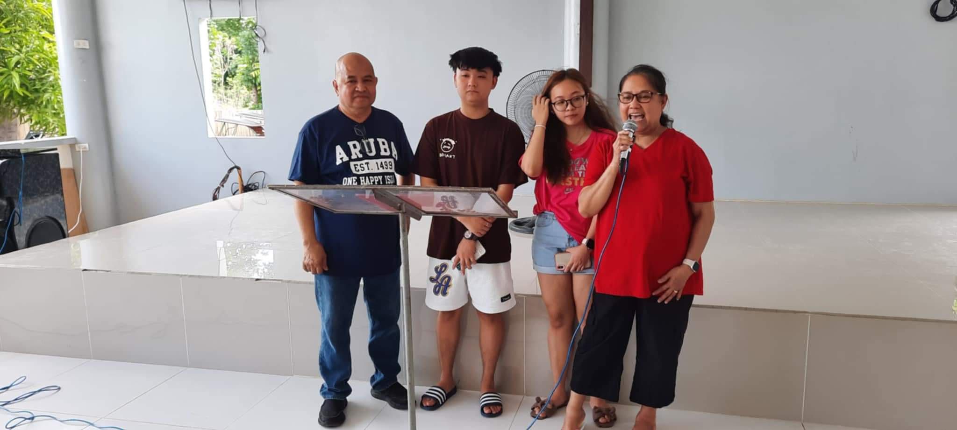
Pastor Roland and Sis Doris visit in JSF General Assembly Meeting

Slide 56
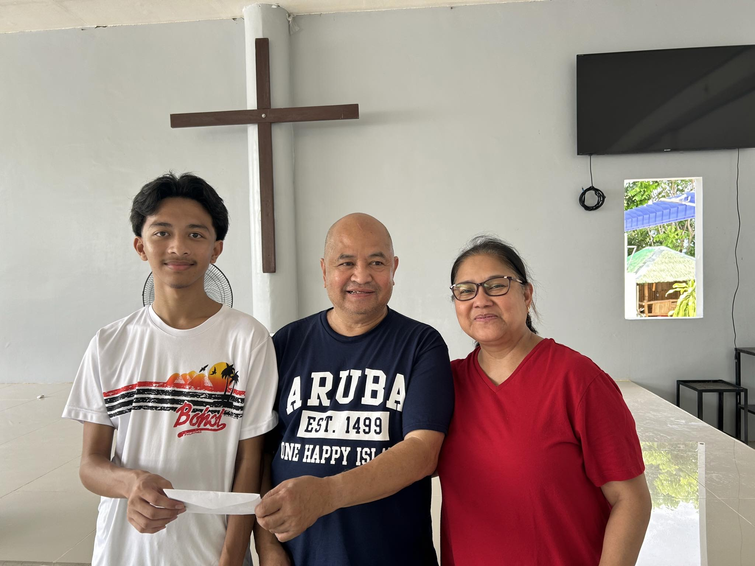
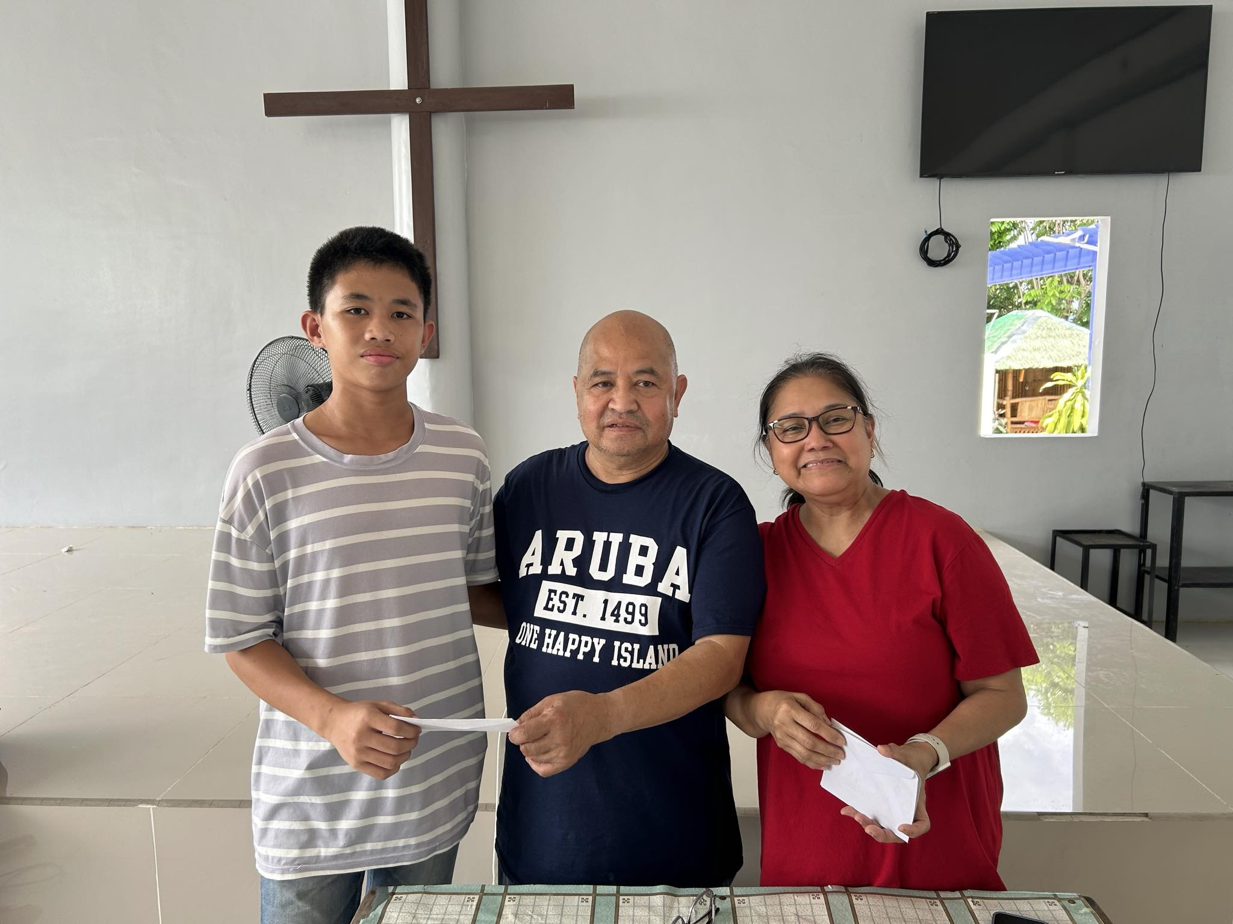
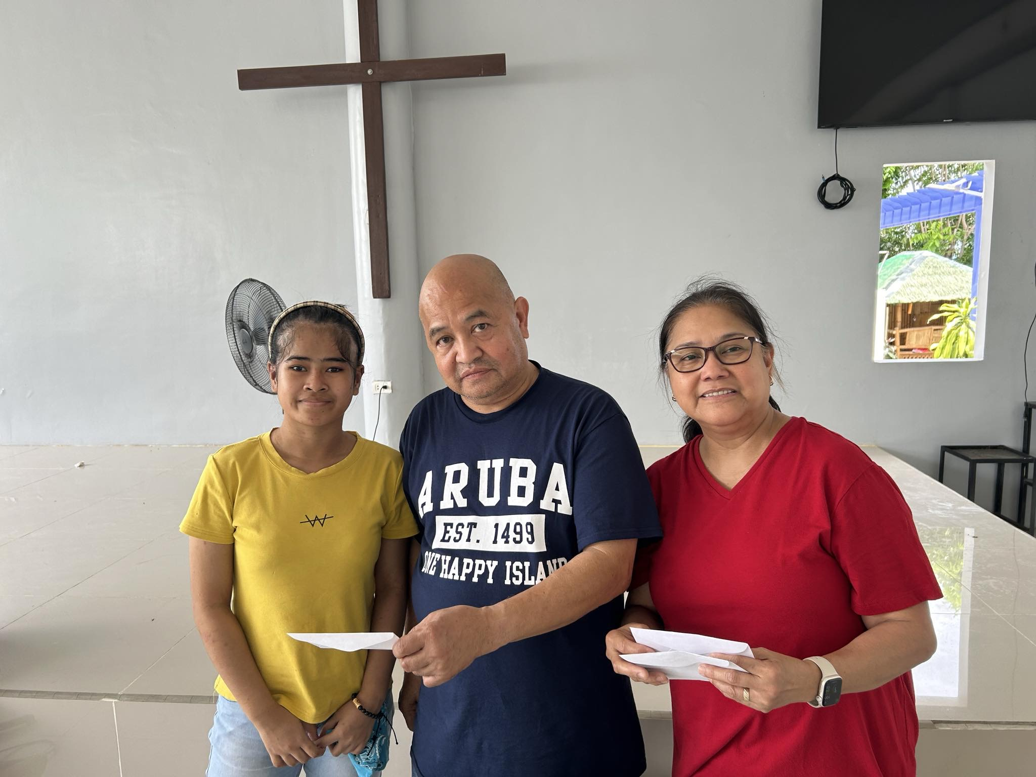
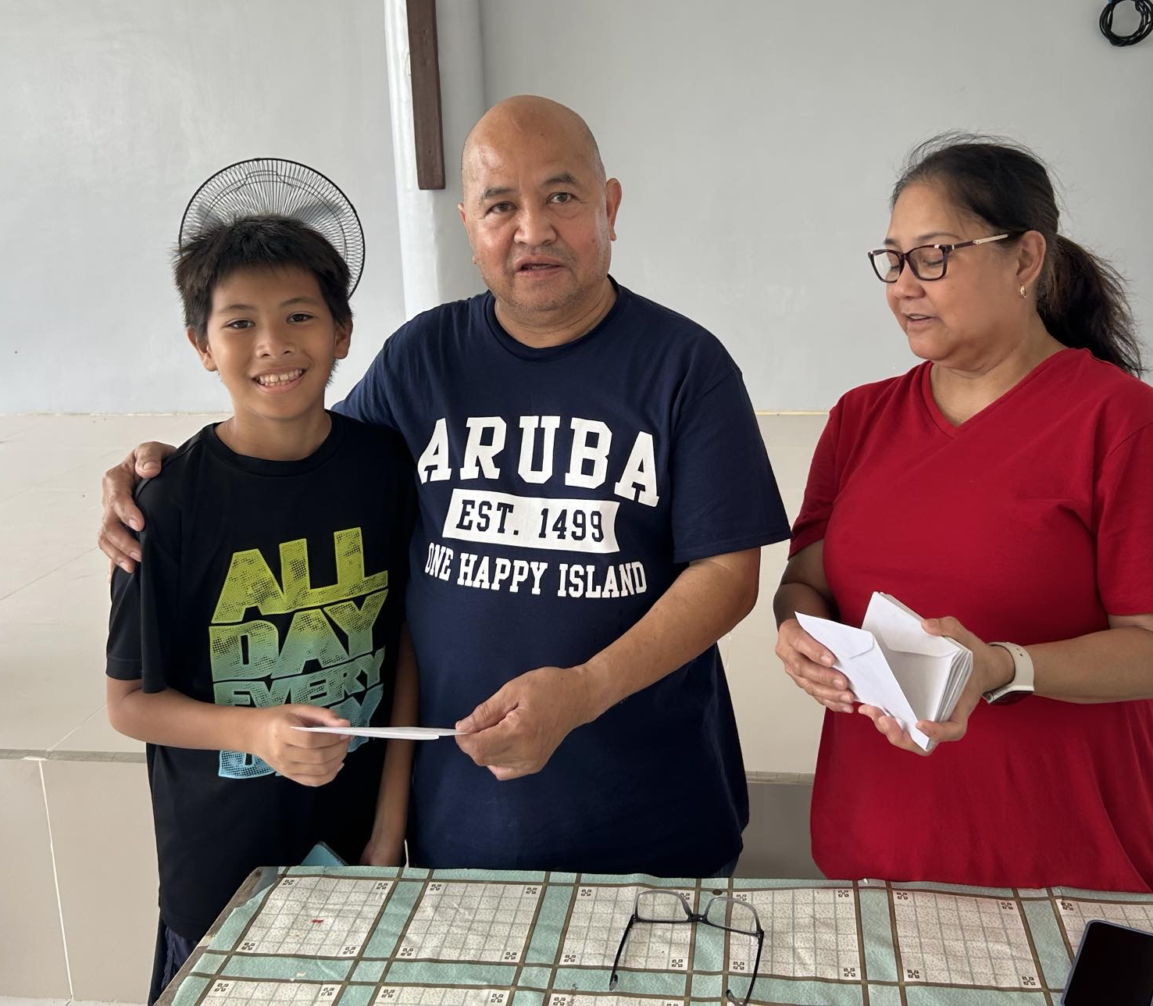
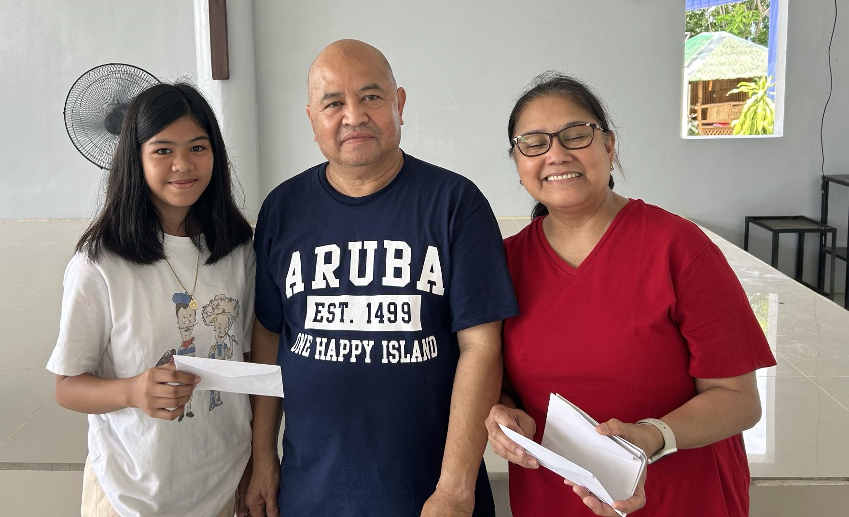
Giving of JSF Financial Support

Slide 57
To all partners and supporters of Jesus Scholarship Foundation….

